Slide 1

Personality Prediction
Akshatha – The Protagonist
Toni – The Advocate
Xiuwen – The Campaigner

Slide 2

Contents
Introduction
Exploratory Analysis
Data Preparation
Feature Engineering
Model Development and Evaluation
Prediction
Conclusion

Slide 3
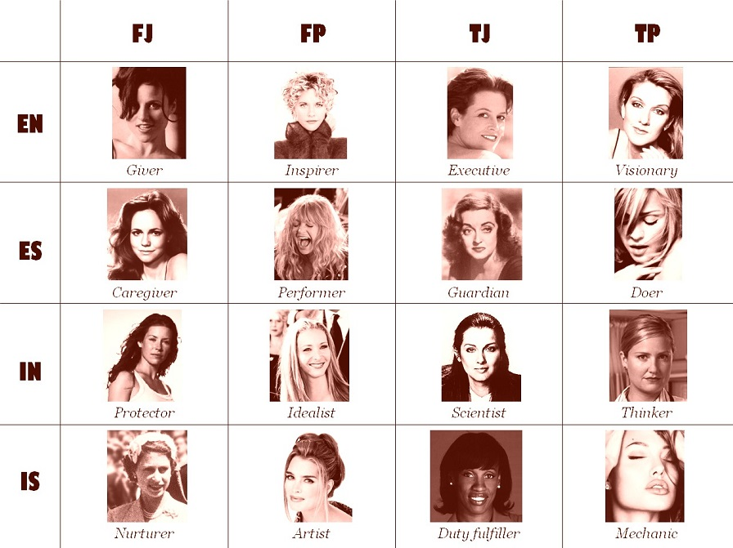
Introduction
Notes:
The origins of personality assessment date back to the 18th and 19th centuries, when personality was assessed through the measurement of bumps on the human skull, and physiognomy, which assessed personality based on a person's outer appearances.
There are many different types of personality assessment measures. The self-report inventory involves administration of many items requiring respondents to introspectively assess their own personality characteristics.
Understanding personality allows psychologists to predict how people will respond to certain situations and the sorts of things they prefer and value. To get a sense of how researchers study personality psychology, it will be helpful to learn more about some of the most influential personality theories.

Slide 4
The Myers-Briggs Type Indicator
The personality type system or Y-variable we used was the Myers-Briggs Type Indicator (MBTI)
The is a personality type system that divides everyone into 16 distinct personality types across 4 axis.
For example, someone who fall under the categories of introversion, intuition, thinking and perceiving would be labelled an INTP in the MBTI system
Introversion (I) | Extroversion (E)
Intuition(N) | Sensing (S)
Thinking (T) | Feeling (F)
Judging (J) | Perceiving (P)
Notes:
The Myers–Briggs Type Indicator (MBTI) is an introspective self-report questionnaire indicating differing psychological preferences in how people perceive the world and make decisions.
The test attempts to assign four categories: introversion or extraversion, sensing or intuition, thinking or feeling, judging or perceiving. One letter from each category is taken to produce a four-letter test result, like "INFJ" or "ENFP".

Slide 5
Objective
In this project, we used text mining and machine learning to train a model which will be able to predict people’s personality character traits using their social media posts.
Tools used :
SVM
Random Forest
﻿Logistic regression
Scikit-learn
nltk & spacy packages
Tf-IDF Vectorizer
Plotly
WordCloud

Slide 6

Exploratory Analysis

Slide 7
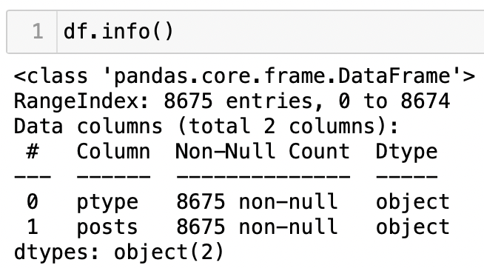
Exploratory Analysis
There are only 2 columns in the dataset (Personality type and Posts)
Total number of rows are 8675
There are no null values present in the dataset
One disadvantage is that all values are textual, hence they must be converted to numerical form to train the ML model
Lastly, there are no repeating posts in the dataset
Notes:
This dataset from Kaggle comes with two columns: the Myers-Briggs type of a user and 50 user posts stored as strings.

Slide 8
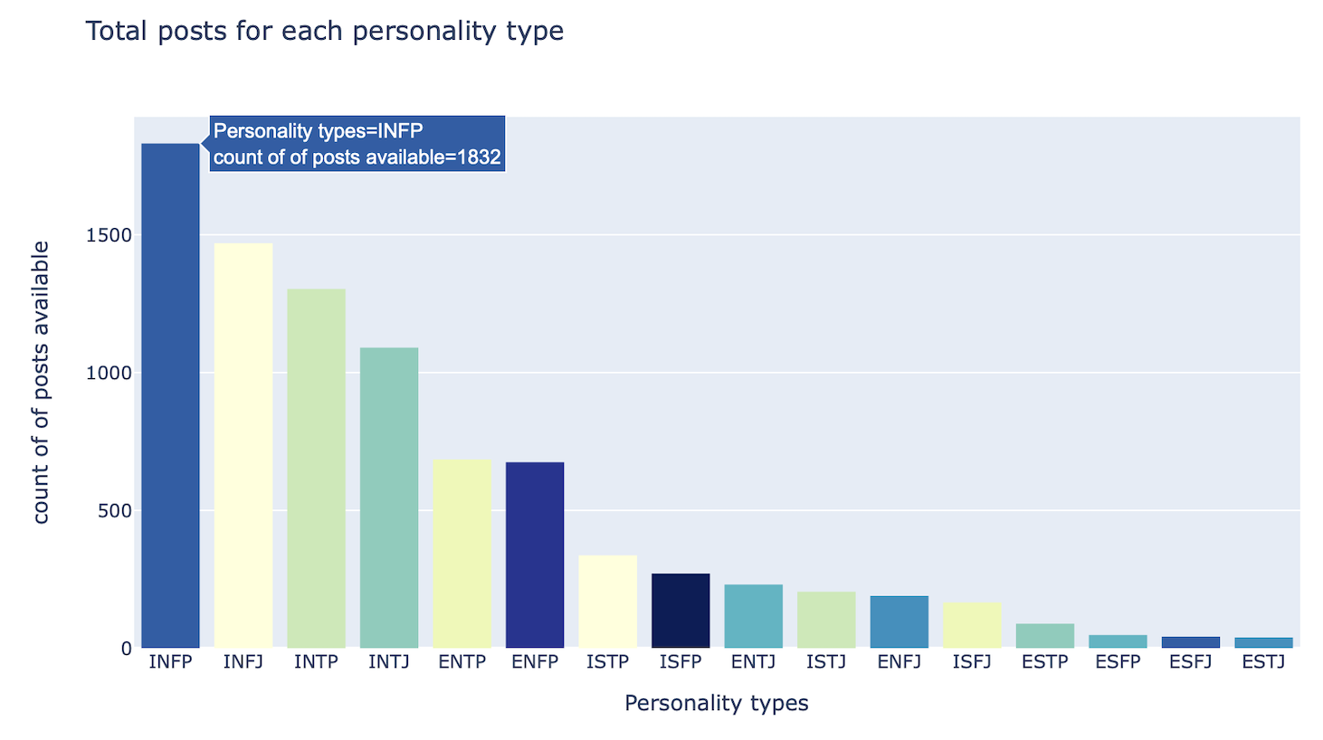
Notes:
There are 16 unique personality type indicators in the dataset
INFP is the most frequently occurring personality type in our dataset (no. of occurrences is 1832)

Slide 9
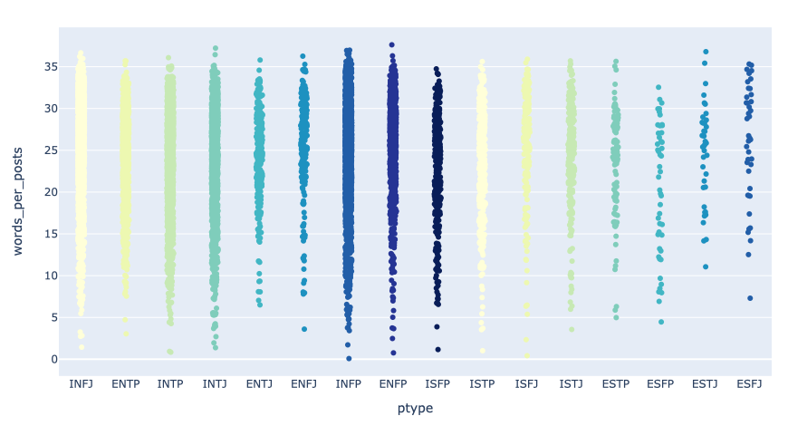
This plot further shows clearly that there are several imbalances in our dataset, showing all the observations along with some representation of the underlying distribution using our added features.
INFP has the most cluttered showing there are the greatest number of comments of this type of personality.

Slide 10
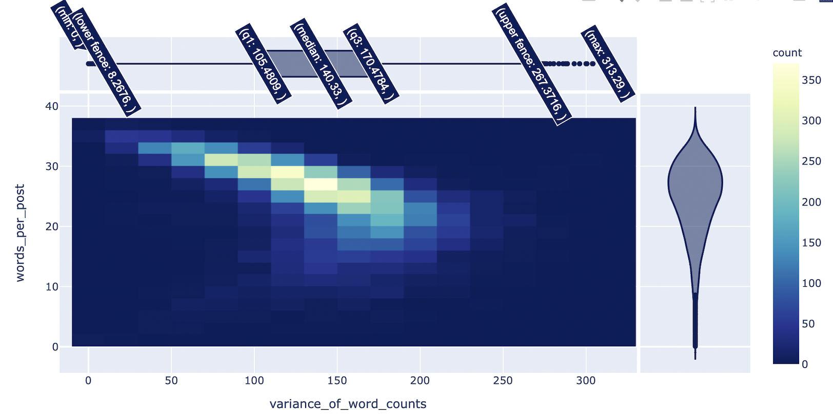
Notes:
The 2 marginal plots represent Gaussian distribution of a sample space, which in our case comprises of no. of words per post and associated variance of word counts from our dataset.
In the density heatmap, the boxes with the greatest number of points gets lighter color. So, if you look at the above plot, you can see that most of the posts have words between 100 and 150 and most of no. of words per comment by a user is between 25-30.
We can see that there is no correlation observed between variance of word count and the words per comment.
There is a strong relationship when there are 25-30 words per comment & the variance of word counts is 100-150

Slide 11
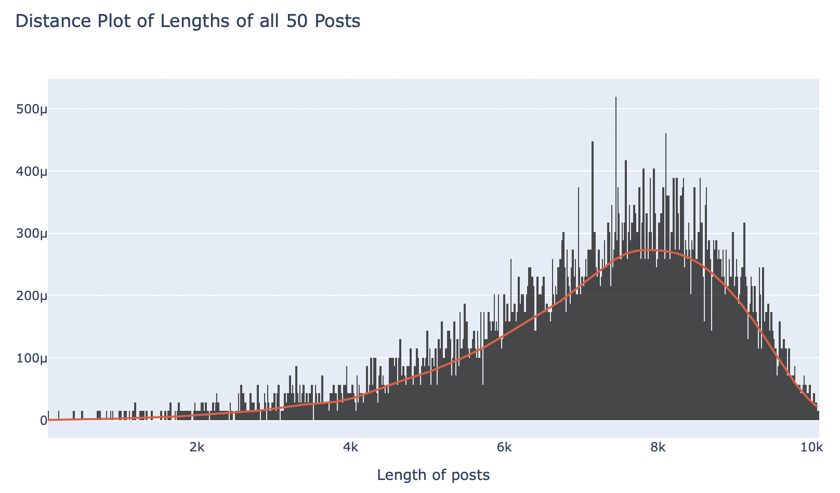
We can see that more number of lengthy posts have between 7000-9000 words.
Notes:
A Density Plot visualises the distribution of data over a continuous interval or time period. This chart is a variation of a Histogram that uses kernel smoothing to plot values, allowing for smoother distributions by smoothing out the noise.

Slide 12
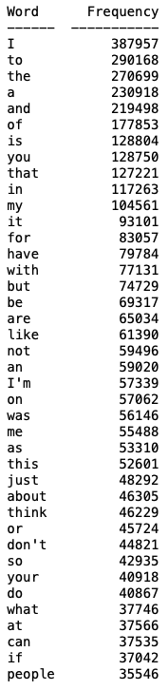
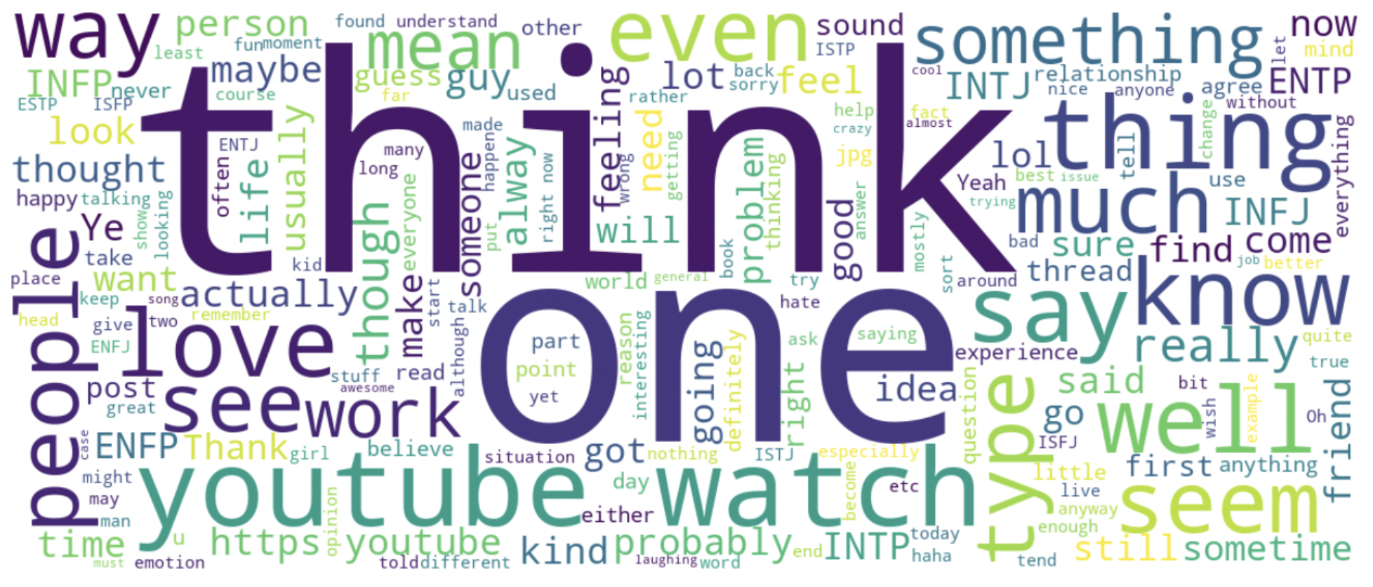
Most Frequent Words

Slide 13
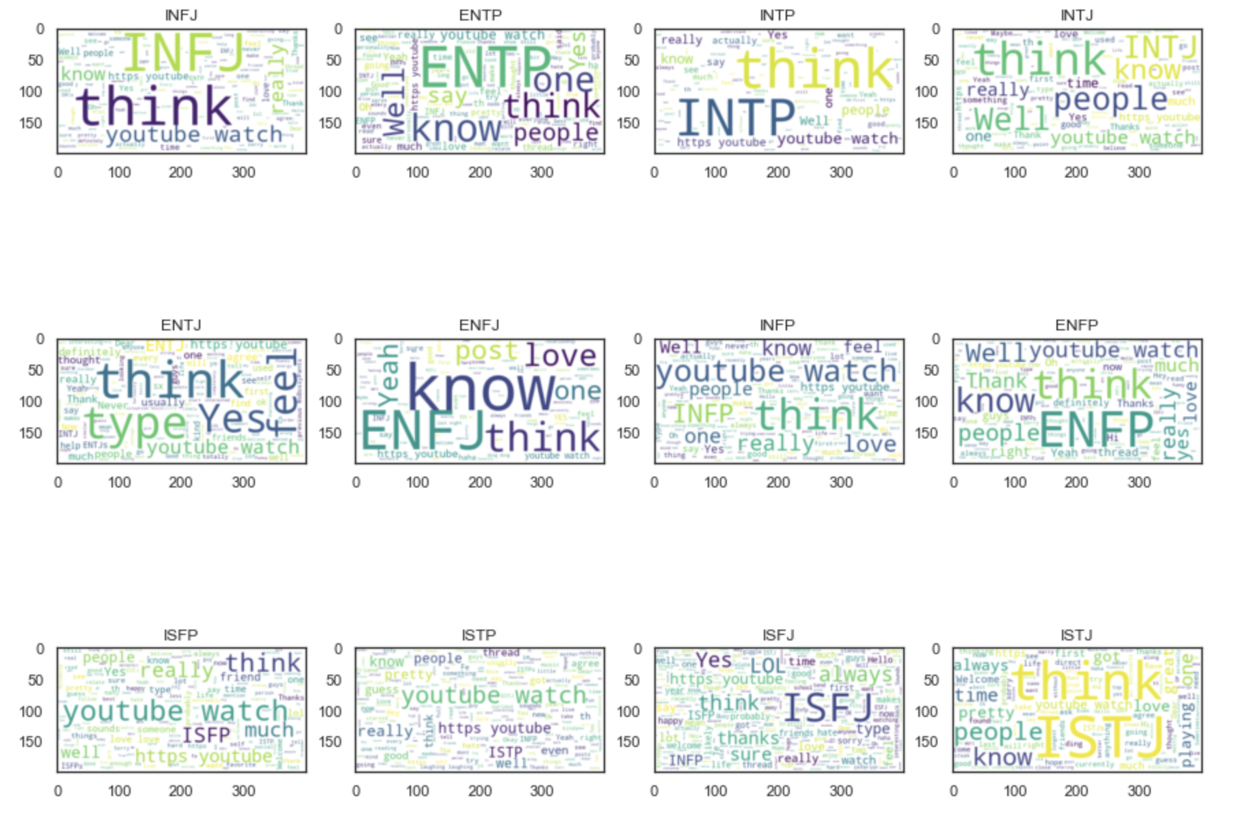
Frequent words per Personality
Notes:
We can see there are several irrelevant words present in the dataset (e.g., ha, ar, Ti etc.) which will need to be removed
Interestingly, among the most common words in the word clouds of individual personality types, is the names of MBTI personality types themselves.
It would hence be necessary to clean our posts by removing these MBTI words from each of them as part of our pre-processing stage, before training the model for better evaluation results.

Slide 14

Data Preparation

Slide 15
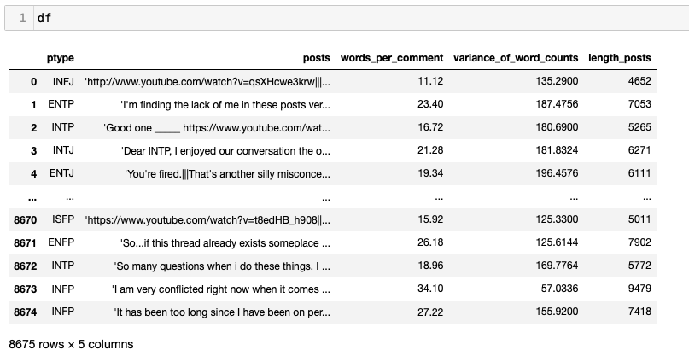
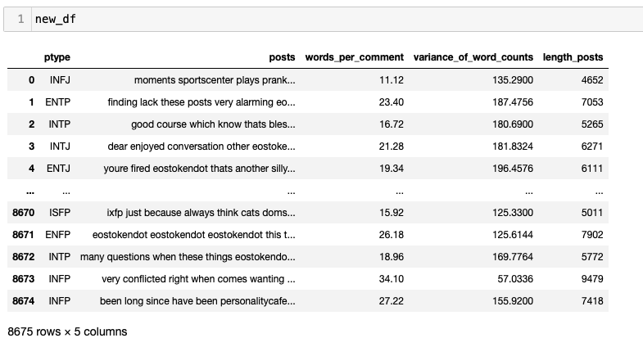
Data Cleaning
Notes:
Pre-processing step - use what tools to remove links, punctuation, multiple full stops, non-words, very long and short words, removed the personality words so words such as INFJ, INFP, ENFP etc.
We also converted the post to lowercase.
It is inferenced that a lot of hyperlinks are present in these posts
It is safe to assume that url links do not provide any real information about a user's personality, hence, we need to clean our dataset for these too.

Slide 16
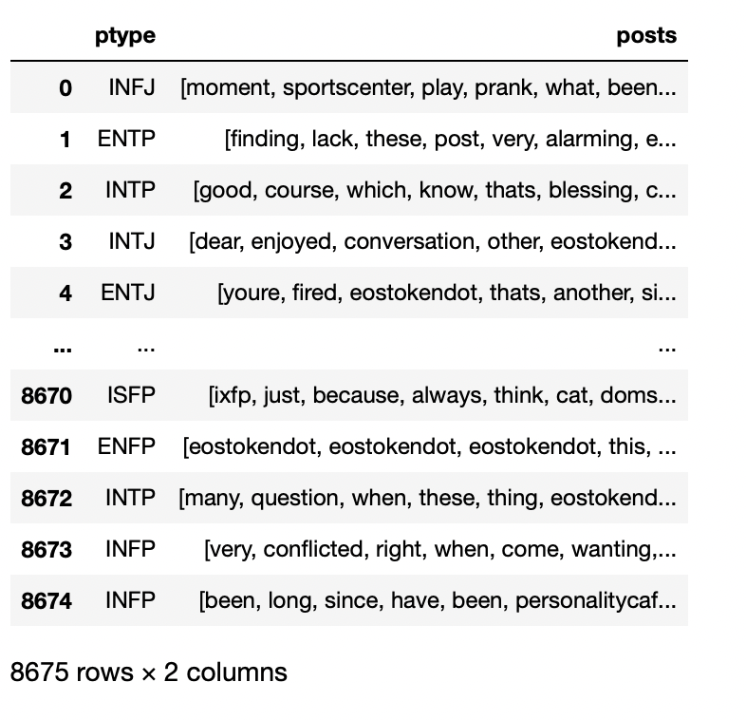
Pre-Processed Data
Tokenize
Lemmatize

Slide 17

Feature Engineering

Slide 18
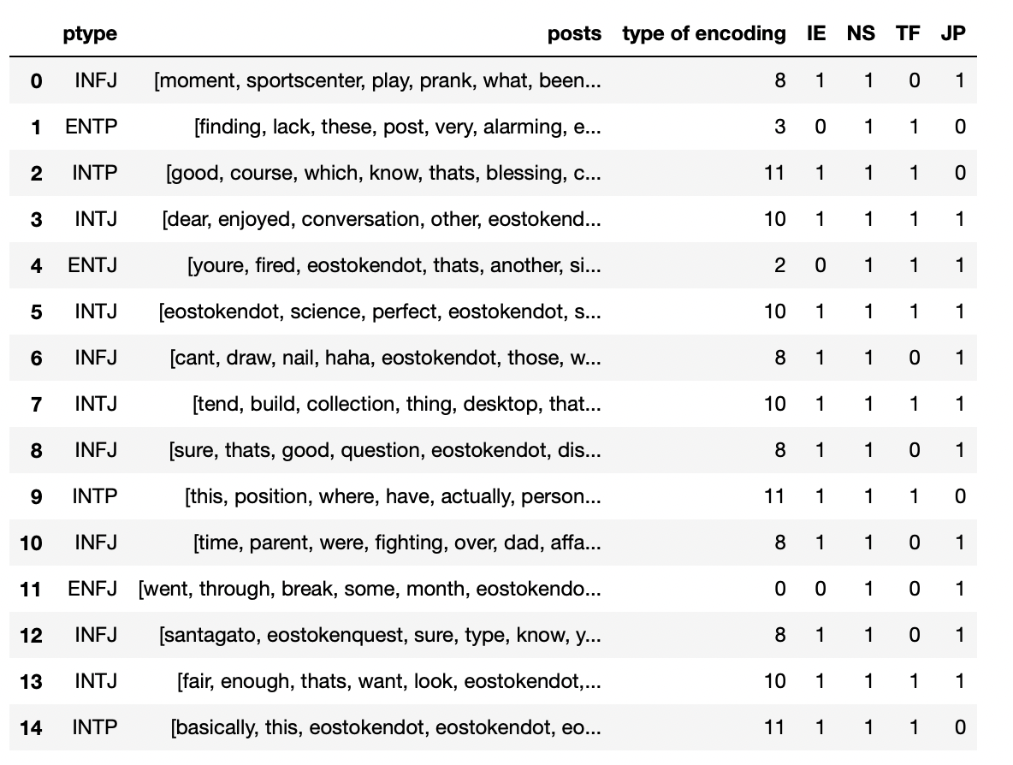
Binary Encoding
Notes:
Using the above code, if a person has I, N, T and J, the value across the 4 axis of MBTI i.e., IE, NS, TF and JP respectively, will be 1. Else 0.
This will help us calculate for e.g., how many Introvert posts are present v/s how many Extrovert posts are present, out of all the given entries in our labelled Kaggle dataset. This is done in order to explore the dataset for all the individual Personality Indices of MBTI

Slide 19
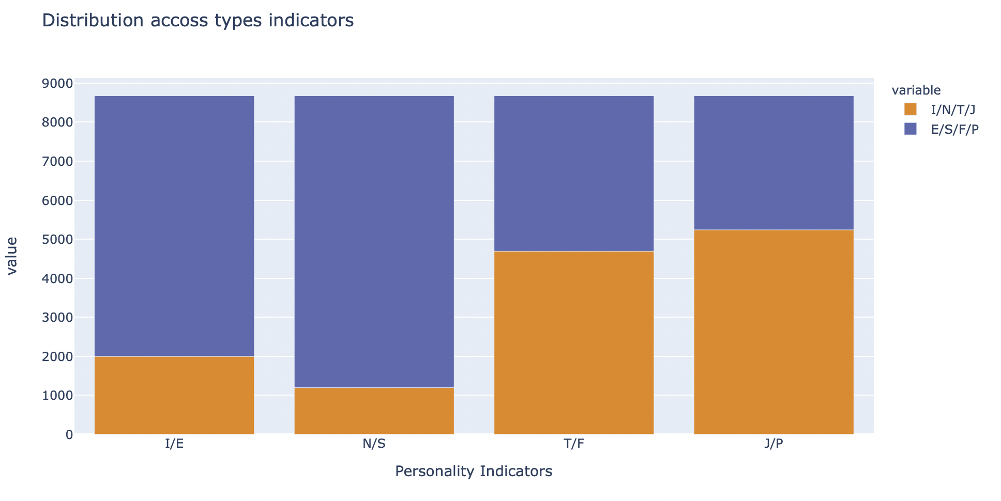
Distribution across types
Fun Fact : The above results match with real life findings by researchers across various personality and psychological studies like
While the population is split roughly 50/50 on the other dimensions, a full 70% of people show a preference for Sensing over Intuition when taking a personality test. Because Intuitive are the minority, the onus is on them to adjust to the Sensor way of thinking.

Slide 20
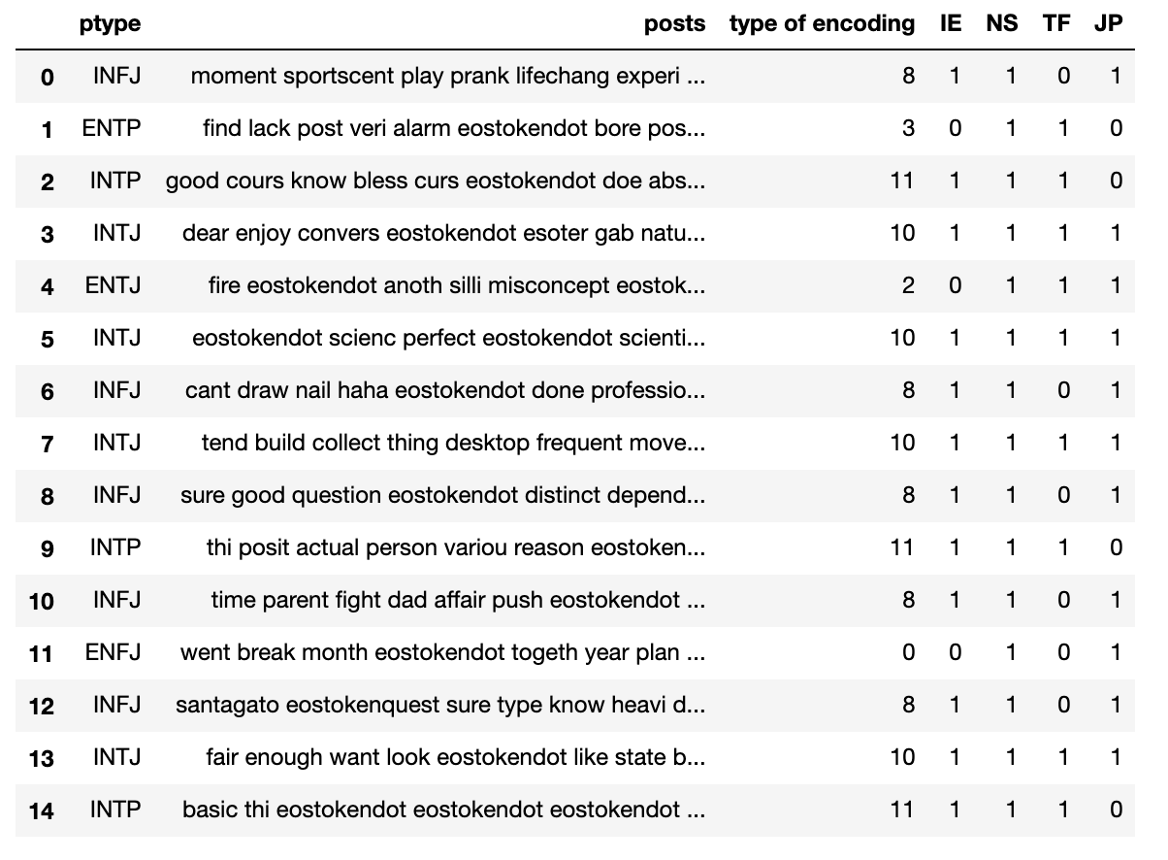
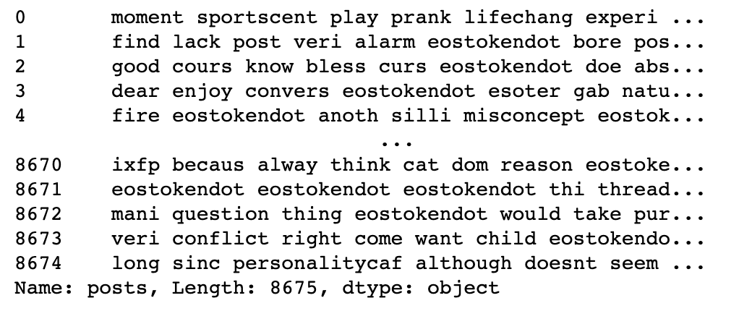
Dataset before vectorization
The posts majorly contain general words like I, I'm, so, me, or, if, and can etc. It is safe to assume that these words won't really provide any useful information to train the ML model as most of them are stop-words, stem-words,
After stemming and removing stop words, we isolated the posts into a variable which we will vectorize for features and then use those features to train our models.

Slide 21
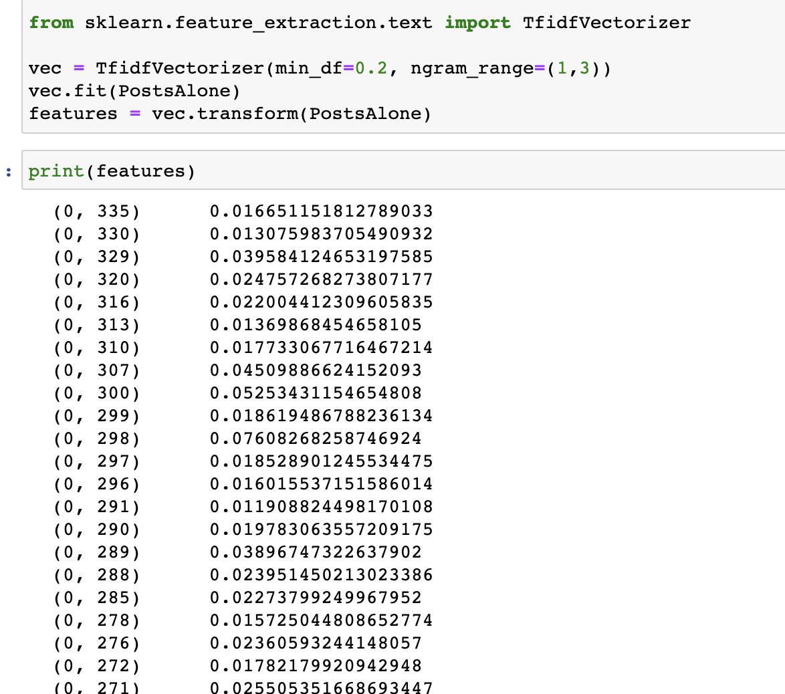
Using the TF-IDF vectorizer
The TF-IDF vectorizer was used to convert our posts to a vector of term/token counts and build a vocabulary of known words, but also to encode new documents using that vocabulary.

Slide 22

Model Development and Evaluation

Slide 23
Model Development and Evaluation
MODEL | TEST ACCURACY
Logistic Regression | 60.7%
SVM | 60.3%
Random Forest | 60.5%
We train Logistic Regression, SVM and Random Forest Classifier models on our features and personality types.
We used train-test split, grid search and regularizations to cross-validate these models for the best accuracy.
First, we aimed to predict J vs P (Judging vs Perceiving). We decided to proceed with the logistic regression model because it gave us the best accuracy but not by much.
Notes:
We only run 3 models for first JP,later use logistic regression, because al 3 models have similar accuracy

Slide 24
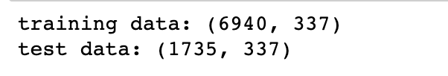
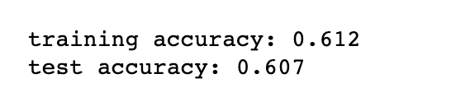
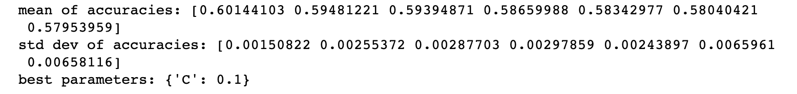
Example: Logistic Regression Model
This was the process when we aimed to predict J vs P (Judging vs Perceiving). We repeated this process for SVM and Random Forest as well as the other personality types (N vs S, T vs F and I vs E)
TRAIN-TEST SPLIT
MODEL ACCURACIES
GRID SEARCH

Slide 25

Prediction

Slide 26

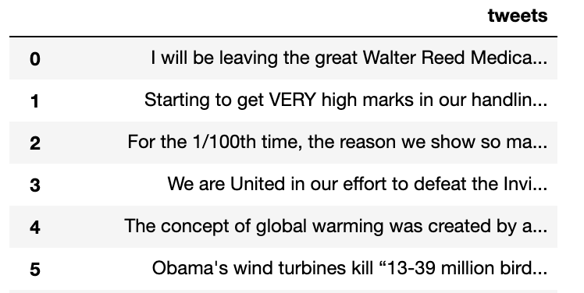
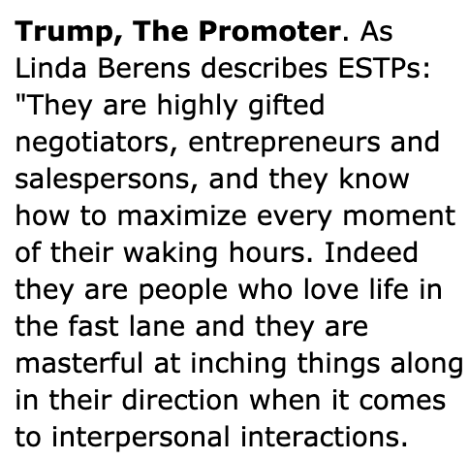
New dataset
Source: personalitypathways.com
Notes:
To test our model, we collected 44 of Donald’s Trump tweets (Before they deactivated his account) and see if we can predict his personality type.
The consensus on his original MBTI appears to be ESTP (Extraversion, Sensing, Thinking, Perceiving)

Slide 27
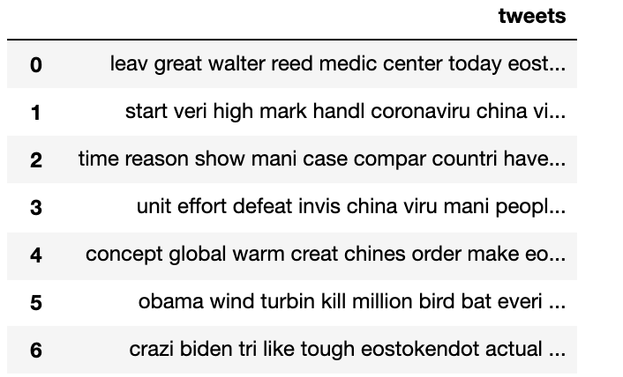
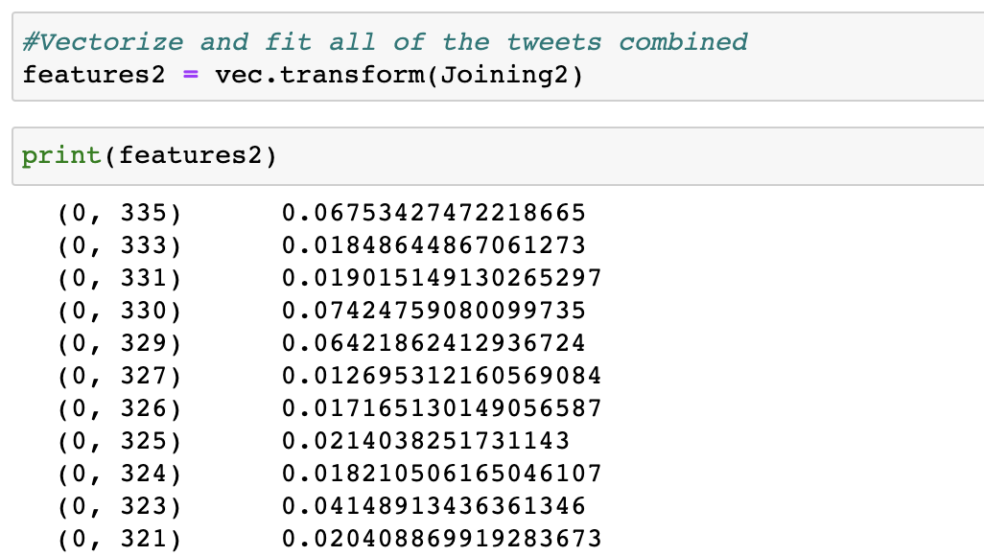
Preparing for prediction
Notes:
Similar to the process for when we were training our original model, we cleaned, pre-processed and vectorized (only fit, not transform) these tweets.
Then we combined them in a list and got their features which we will use to predict Trump’s personality.

Slide 28
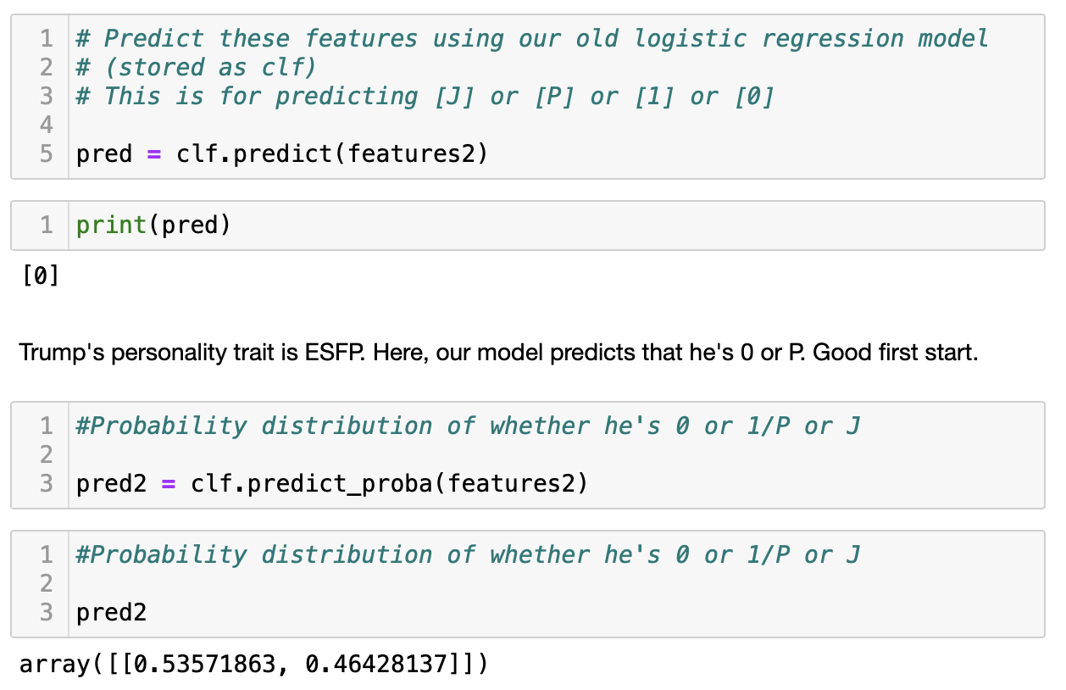
Predictions
Our first model looking at J vs P predicts that Trump is a P, i.e., has a Perceiving character trait.
Repeating this step with the four personality types, show us that Trump is ESFP.
We also calculated the probability that he is on one personality axis or the other. For example, with J vs P, the model states that it is 54% that he is P and 46% that he is J.

Slide 29

Conclusion
Our aim with this project was to create a machine learning model that can use features derived from text to predict people’s personalities.
After training our model, we decided to predict Donald’s Trump personality and got ESFP, which close to the consensus of his personality (ESTP).

Slide 30
References
https://www.personalitypathways.com/article/trump-mbti-type.html

